Slide 1

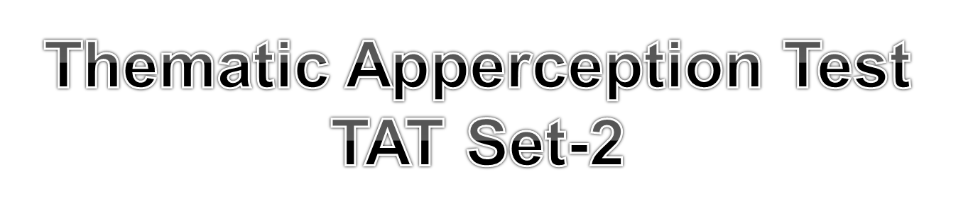
To know more about TAT read the linked article:
http://www.ssbcrack.com/2013/02/thematic-apperception-test-tat-of-ssb.html
Visit: www.ssbcrack.com for more free guidance and study material on SSB interview
www.ssbcrack.com

Slide 2
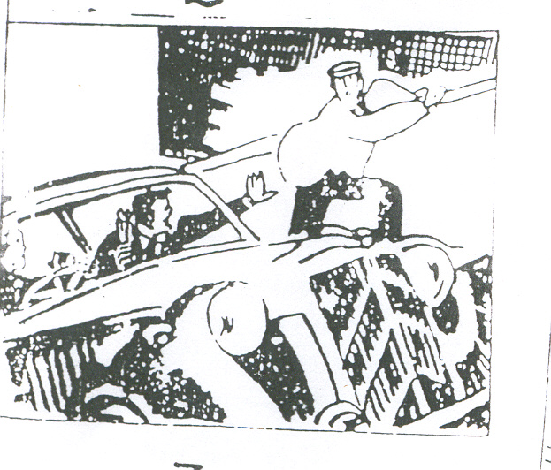
www.ssbcrack.com

Slide 3

www.ssbcrack.com

Slide 4
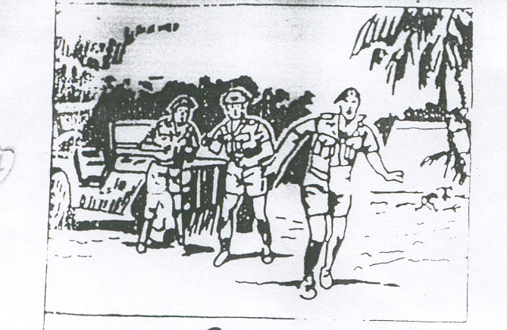
www.ssbcrack.com

Slide 5
www.ssbcrack.com

Slide 6
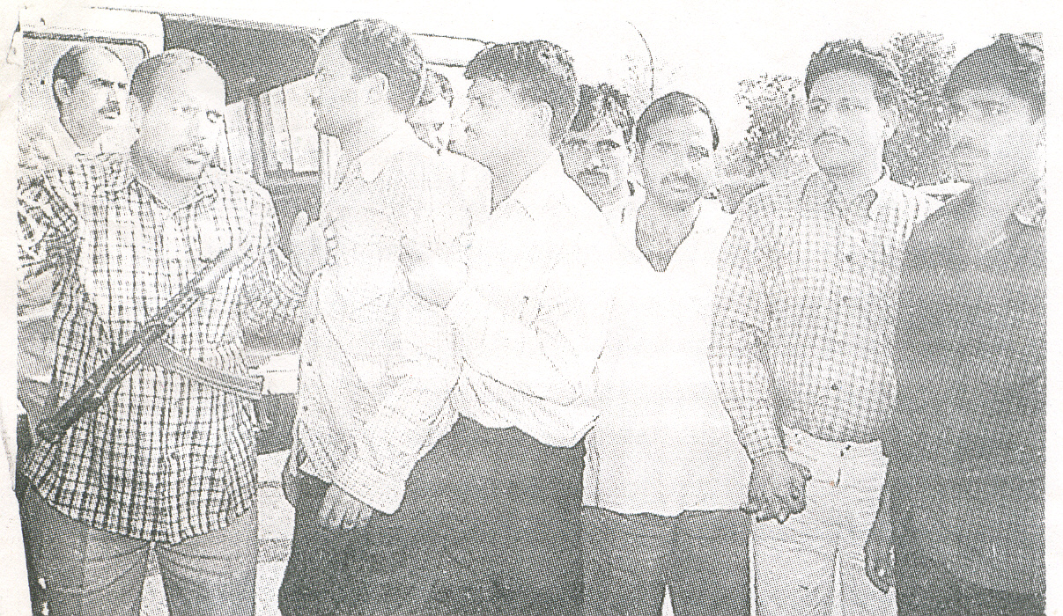
www.ssbcrack.com

Slide 7
www.ssbcrack.com

Slide 8
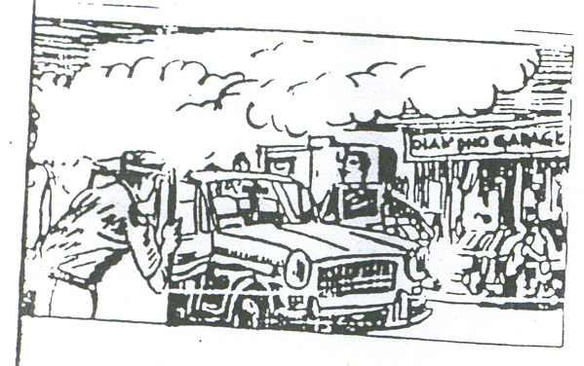
www.ssbcrack.com

Slide 9
www.ssbcrack.com

Slide 10
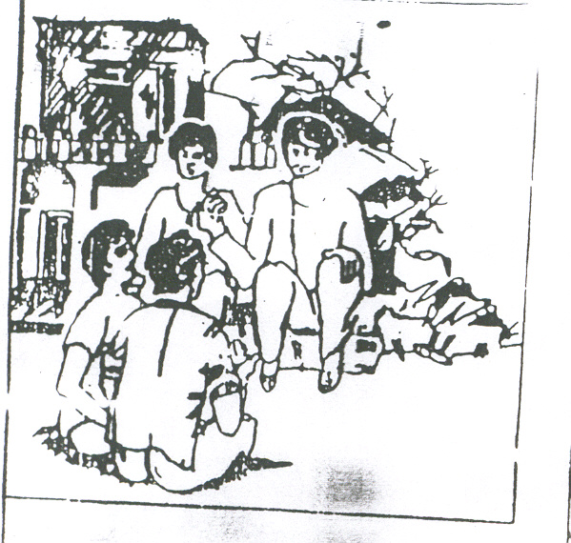
www.ssbcrack.com

Slide 11
www.ssbcrack.com

Slide 12
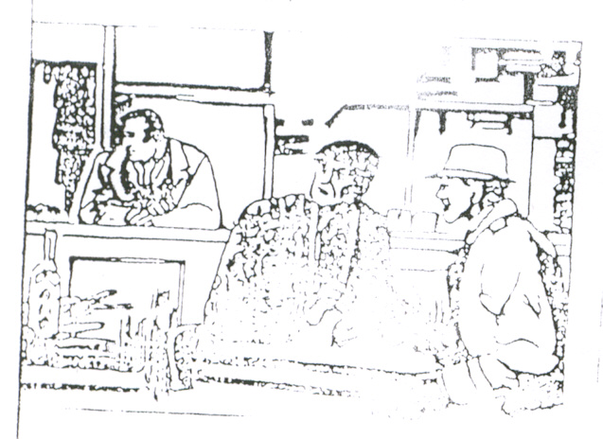
www.ssbcrack.com

Slide 13
www.ssbcrack.com

Slide 14
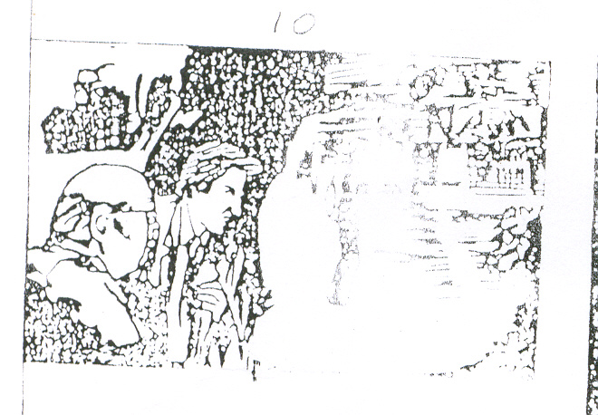
www.ssbcrack.com

Slide 15
www.ssbcrack.com

Slide 16
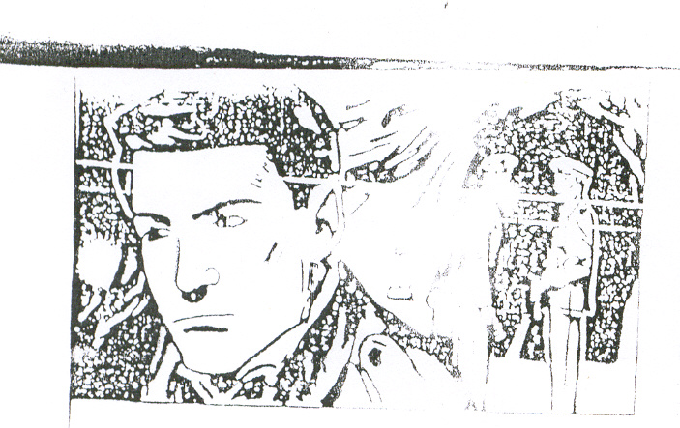
www.ssbcrack.com

Slide 17
www.ssbcrack.com

Slide 18
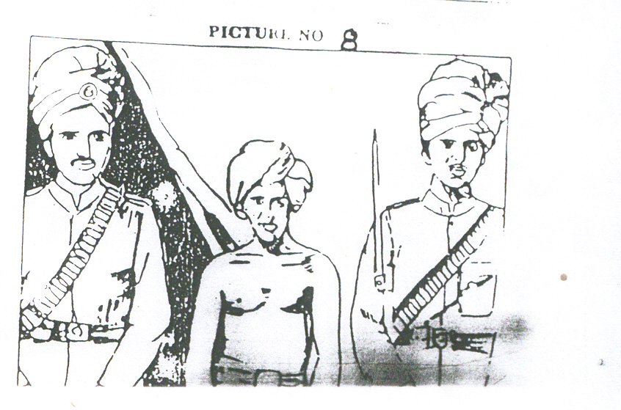
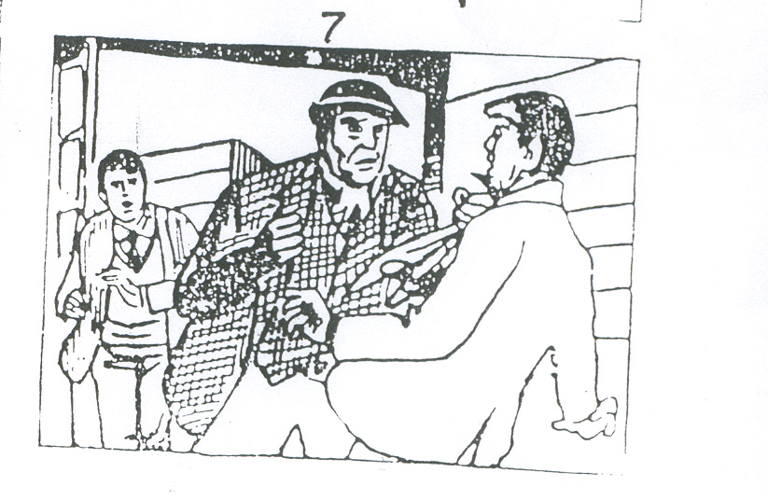
www.ssbcrack.com

Slide 19
www.ssbcrack.com

Slide 20
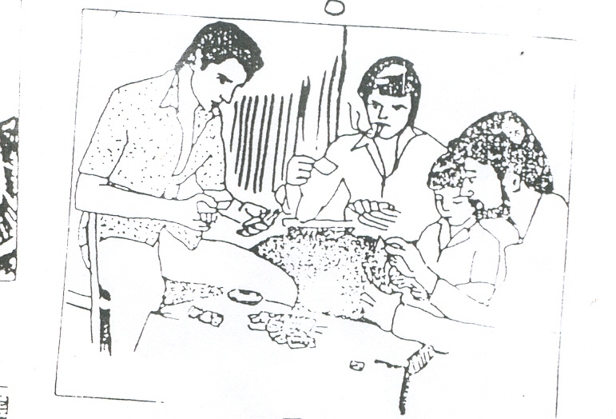
www.ssbcrack.com

Slide 21
www.ssbcrack.com

Slide 22
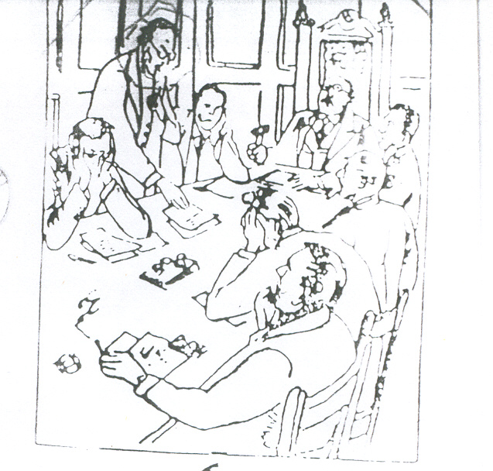
www.ssbcrack.com

Slide 23
www.ssbcrack.com

Slide 24
Blank slide
www.ssbcrack.com

Slide 25

www.ssbcrack.com

